Slide 1
Discrete Structures
CS-1005
GCR: e2d2awt
Lecture-5

Slide 2
Logic
Logic is the study of the principles and methods that distinguishes between a valid and an invalid argument.
• Logic: the science of reasoning, how to derive conclusion from premises in a valid way
Premises and Conclusion
The assertion at the end of the sequence is called the conclusion, and the preceding statements are called premises.
Example:
If Jane is math major or Jane is computer science major then Jane will take math 150

Slide 3
Logic
Applications
Applied in proving program correctness and verification
Databases (Relational Algebra and calculus)
Artificial Intelligence

Slide 4
Propositional Logic
Proposition
A proposition is a declarative statement that is either TRUE or FALSE, but not both.
Example 1
2 + 2 = 4.
Lahore is the capital of Pakistan.
It is Sunday today.
Ali is student of this class.
Example 2
What time is it?
X + 1 = 2.
Close the door.
Read this carefully.

Slide 5
Propositional Logic
Letter are used to denote propositional variables, to symbolically represent propositions.
Letters used for this purpose are p, q, r, s,………
A propositional can have one of two values: true (T) or false (F).
Example
p = “Islamabad is the capital of Pakistan”
q = “17 is divisible by 3”

Slide 6
Propositional Logic
Applications
Translating English sentences (Formalization)
System Specifications
Boolean Searches
Logic circuits

Slide 7
Propositional Logic
The area of logic that deals with propositions is called the Propositional Calculus or Propositional Logic.
Compound Propositions are constructed by combining one or more propositions using logical operators (connectives).
Examples
“3 + 2 = 5” and “Lahore is a city in Pakistan”
“The grass is green” or “ It is hot today”

Slide 8
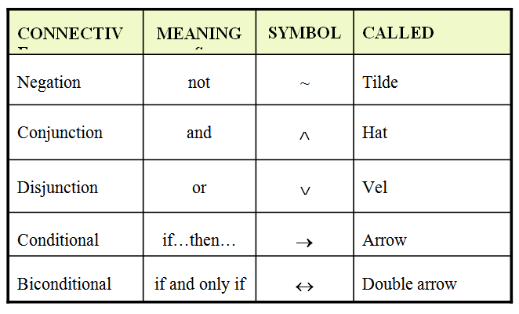
Propositional Logic

Slide 9
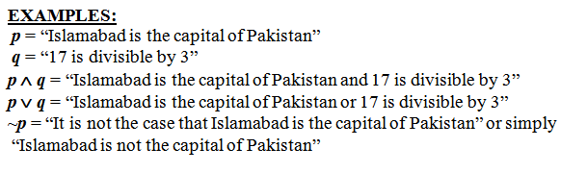
Propositional Logic

Slide 10
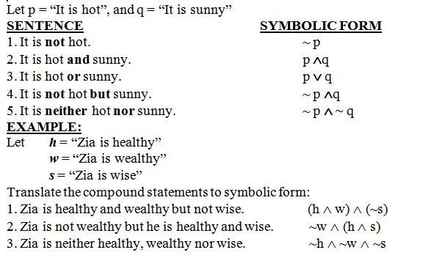
Propositional Logic

Slide 11
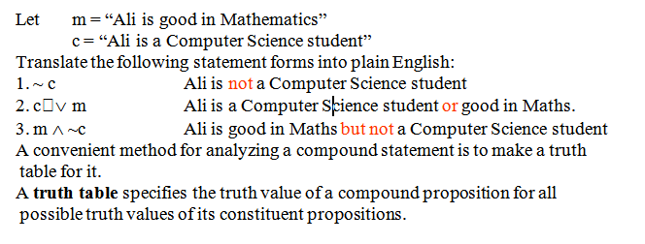
Propositional Logic

Slide 12
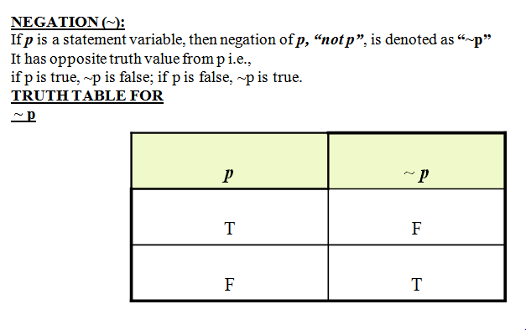
Propositional Logic

Slide 13
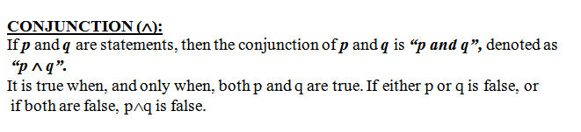
Propositional Logic

Slide 14
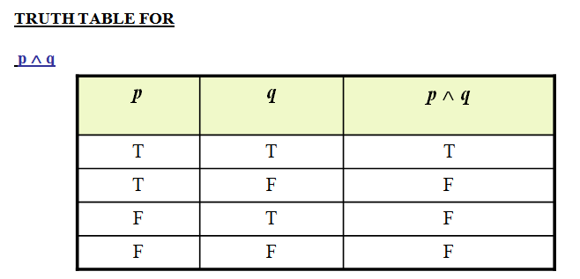
Propositional Logic

Slide 15
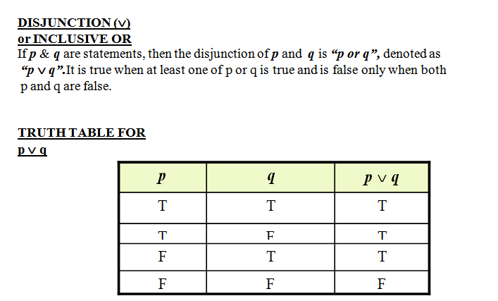
Propositional Logic

Slide 16
Propositional Logic
When or is used in its exclusive sense, the statement “p or q” means “p or q but not both” or “p or q and not p and q” which translates into symbols as:
(p ∨ q) ∧ ~ (p ∧ q)
Which is abbreviated as:
p ⊕ q
or p XOR q

Slide 17
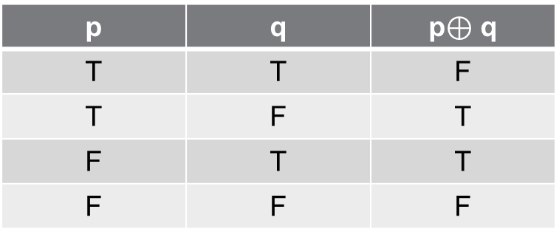

Propositional Logic
Symbol: $⊕$
Let p and q be propositions. The exclusive or of p and q, denoted by p $⊕$ q , is the proposition that is true when exactly one of p and q is true and is false, and false otherwise.
Truth Table
p | q | p$⊕$ q
T | T | F
T | F | T
F | T | T
F | F | F

Slide 18
Propositional Logic
p → q corresponds to English “if p then q,” or “p implies q.”
Symbol: →
The implication p → q is the proposition that is false when p is true and q is false, and true otherwise.
p → q
Examples
If it is raining then it is cloudy.
If you get 100% on the final, then you will get an A.
If p then 2+2 = 4.
Hypothesis
Conclusion

Slide 19
Propositional Logic
p | q | p → q
T | T | T
T | F | F
F | T | T
F | F | T

Slide 20
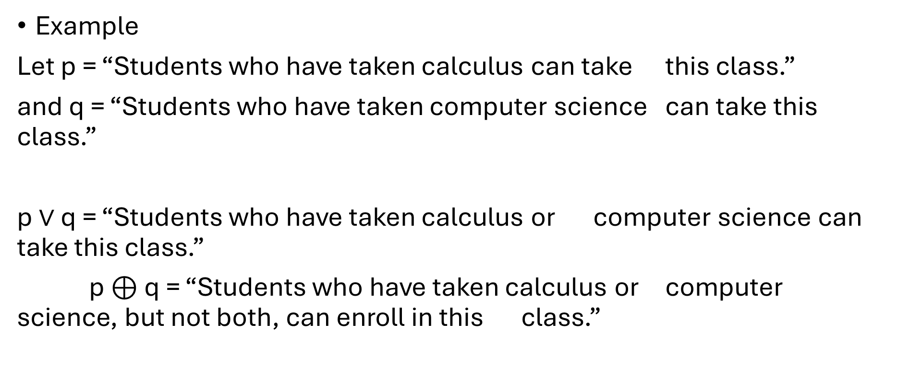
Propositional Logic
Example
Let p = “Students who have taken calculus can take this class.”
and q = “Students who have taken computer science can take this class.”
p $∨$ q = “Students who have taken calculus or computer science can take this class.”
p $⊕$ q = “Students who have taken calculus or computer science, but not both, can enroll in this class.”

Slide 21
Propositional Logic
Coffee or tea comes with dinner.
A password must have at least three digits or be at least five characters long.
Lunch includes soup or salad.
Experience with C++ or Java is required.

Slide 22
Propositional Logic
Alternate ways of stating an implication
p implies q
If p, q
p only if q
p is sufficient for q
q if p
q whenever p
q is necessary for p

Slide 23
Propositional Logic
p: you get 100% on the final
q: you will get an A
p implies that q.
you get 100% on the final implies that you will get an A.
If p, then q.
If you get 100% on the final, then that you will get an A.
If p, q.
If you get 100% on the final, that you will get an A.
p is sufficient for q.
Get 100% on the final is sufficient for getting an A.
q if p.
you will get an A if you get 100% on the final.
q unless ￢ p.
you will get an A unless you don’t get 100% on final.

Slide 24
Propositional Logic
Converse
The proposition q → p is converse of p → q.
Contrapositive
The contrapositive of p → q is the proposition ￢q →￢p.
Inverse
The proposition ￢p →￢q is called the inverse of p → q.

Slide 25
Propositional Logic
Example
“The home team wins whenever it is raining?”
Because “q whenever p”, so p → q, the original statement can be rewritten as “If it is raining, then the home team wins.”
Contrapositive
“If the home team does not win, then it is not raining.”
Converse
“If the home team wins, then it is raining.”
Inverse
“If it is not raining, then the home team does not win.”

Slide 26
Propositional Logic
p ↔ q corresponds to English “p if and only if q.”
Symbol: ↔
The bi-conditional statement p ↔ q is true when p and q have the same truth values, and is false otherwise.
Bi-conditional statements are also called bi-implications.
Alternatively, it means “(if p then q) and (if q then p)”
Example
“You can take the flight if and only if you buy a ticket.”

Slide 27
Propositional Logic
p | q | p ↔ q
T | T | T
T | F | F
F | T | F
F | F | T

Slide 28
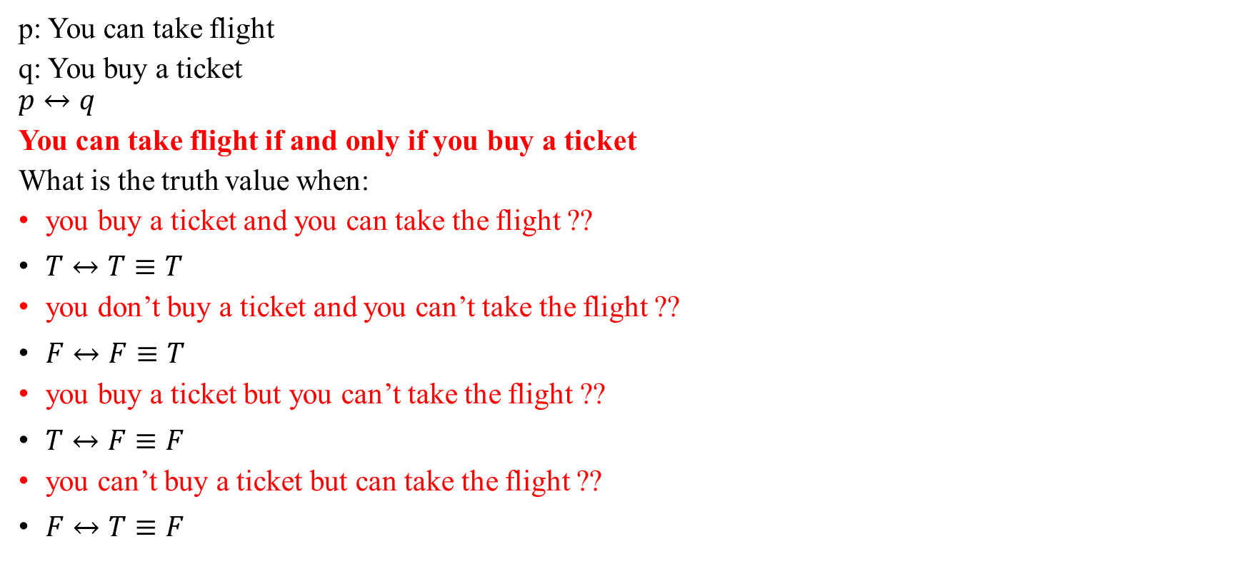
Propositional Logic
p: You can take flight
q: You buy a ticket
$$p↔q$$
You can take flight if and only if you buy a ticket
What is the truth value when:
you buy a ticket and you can take the flight ??
$T↔T≡T$
you don’t buy a ticket and you can’t take the flight ??
$F↔F≡T$
you buy a ticket but you can’t take the flight ??
$T↔F≡F$
you can’t buy a ticket but can take the flight ??
$F↔T≡F$

Slide 29
Propositional Logic
Other English equivalents:
“p if and only if q”
“p is equivalent to q”
“p is necessary and sufficient for q”
“If p then q, and conversely”

Slide 30
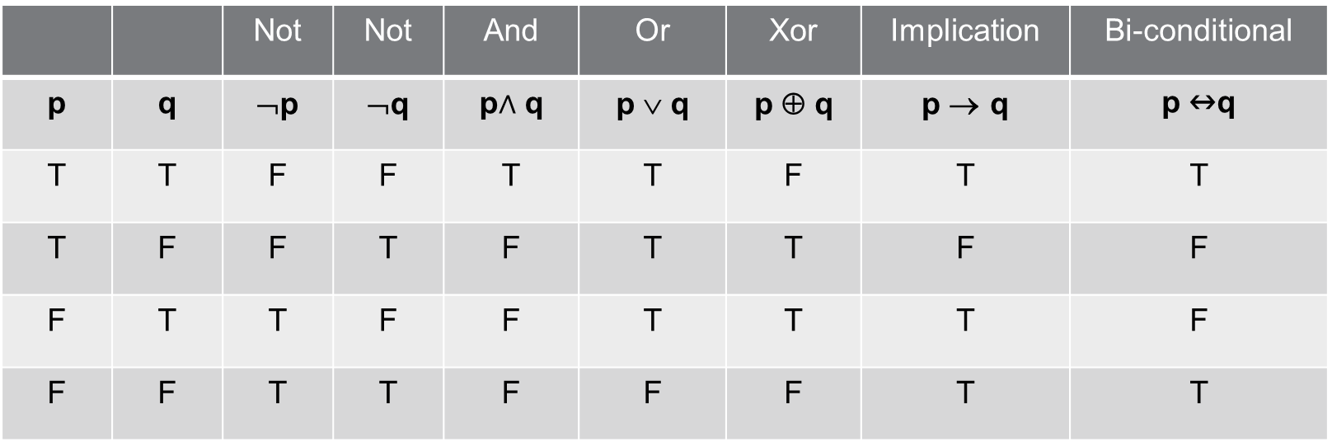
Propositional Logic
 |  | Not | Not | And | Or | Xor | Implication | Bi-conditional
p | q | ¬p | ¬q | p$∧$ q | p ∨ q | p ⊕ q | p → q | p ↔q
T | T | F | F | T | T | F | T | T
T | F | F | T | F | T | T | F | F
F | T | T | F | F | T | T | T | F
F | F | T | T | F | F | F | T | T

Slide 31
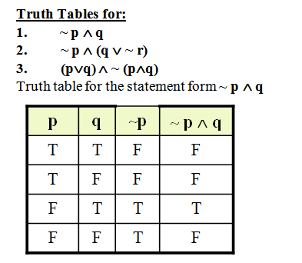
Propositional Logic

Slide 32
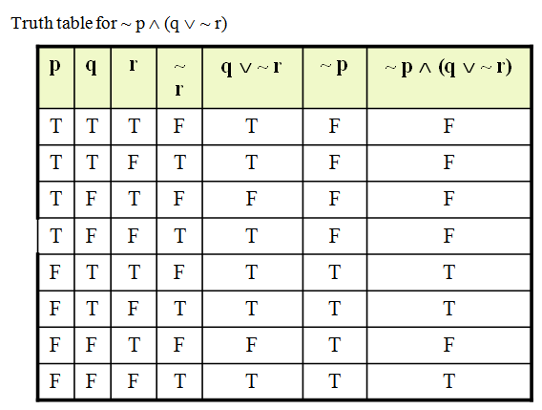
Propositional Logic

Slide 33
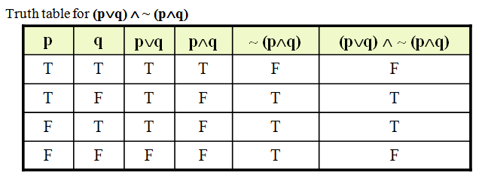
Propositional Logic

Slide 34
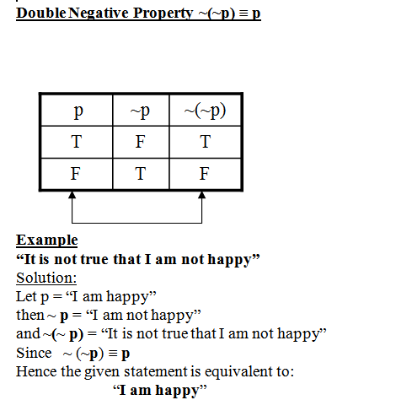
Propositional Logic

Slide 35
Propositional Logic
p | q | ￢q | p ∨￢q | p ∧ q | (p ∨￢q) → (p ∧ q)
T | T | F | T | T | T
T | F | T | T | F | F
F | T | F | F | F | T
F | F | T | T | F | F

Slide 36
Propositional Logic
p → (￢q ∧ r )
p | q | r | ￢q | ￢q ∧ r | p → (￢q ∧ r )
T | T | T | F | F | F
T | T | F | F | F | F
T | F | T | T | T | T
T | F | F | T | F | F
F | T | T | F | F | T
F | T | F | F | F | T
F | F | T | T | T | T
F | F | F | T | F | T

